Slide 1


From Sample Preparation to Sequencing:
Experimental Design
and Library Preparation
Annelien Verfaillie
25th oct 2023

Slide 2
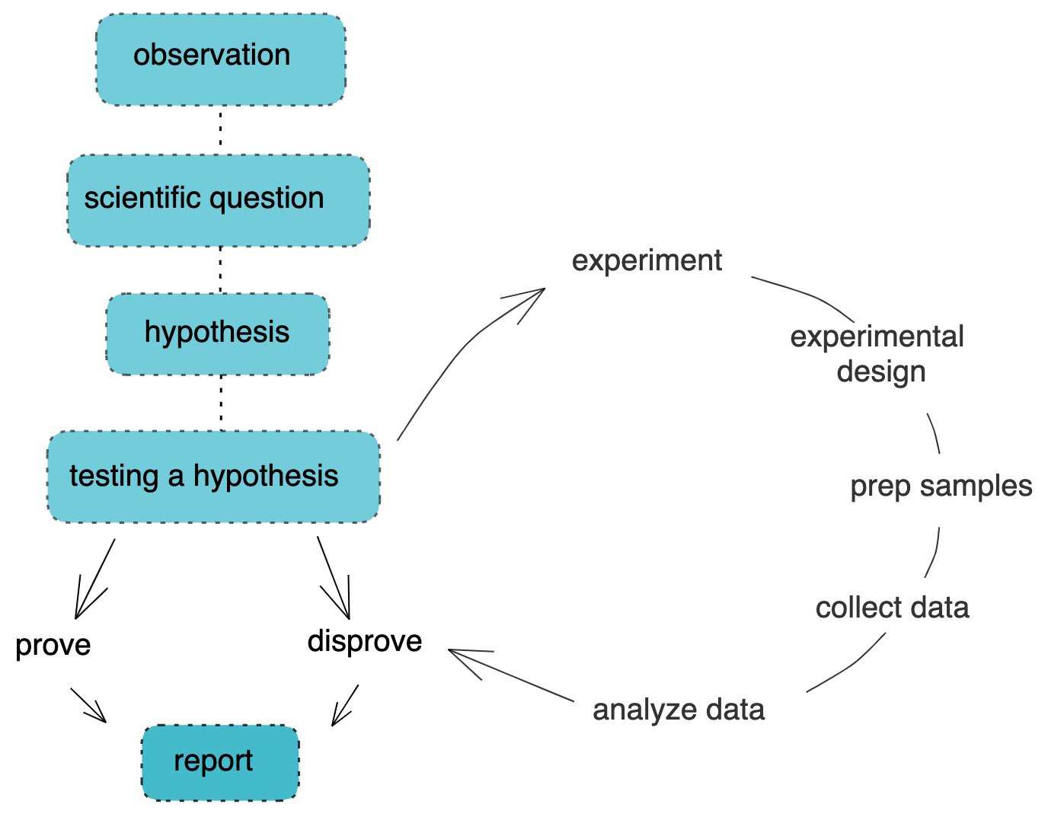
Notes:
You have a biological question and you are looking for the best way to answer. We are here today to give you an insight in how RNA-seq works and how it might fit into your scientific work and help you get some of your answers to your questions.
Just like any experiment RNA-seq starts with a good experimental design. Once you have this in place you can move into preparing and executing the experiments to gather your data. You then proceed to analysing this data to look at what answers you can find with regards to your question.

Slide 3
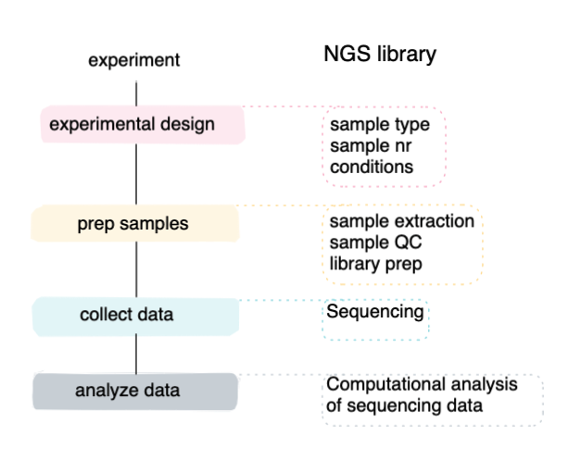

Slide 4
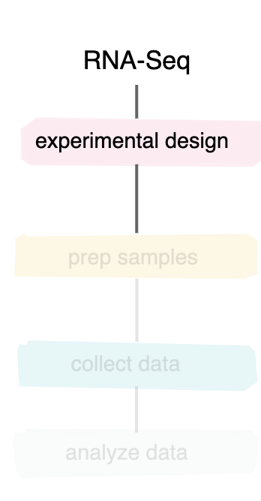
What is my scientific question?
Quantify
Identify
NGS library
Difference between conditions
Change over time
De novo assembly
Fusions, SNPs, structural variance
…

Slide 5
What is my scientific question?
Quantify
Identify
NGS library
Difference between conditions
Change over time
De novo assembly
Fusions, SNPs, structural variance
…
What do I need?
replicates
control
Purpose of replicates
Biological vs technical
Variability of your population
What is feasible
Purpose of control
Experimental question
feasibility

Slide 6
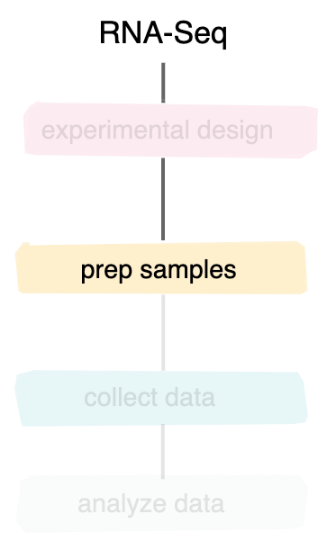
Set up experiment
info@genomicscore.be
NGS library
You
Extract material
QC
You or the genomics core
Library prep

Slide 7

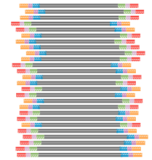
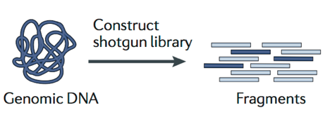

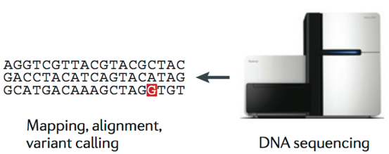
General workflow
material of interest
Input prep and QC
Library
Data analysis

Slide 8
General workflow
Library preparation
material of interest
Input prep and QC
Library
Data analysis

Slide 9

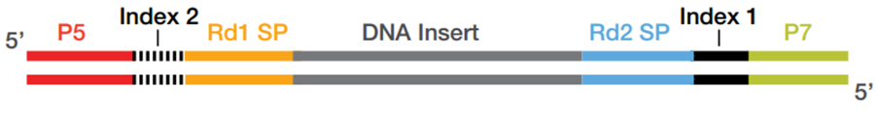
Purpose of library prep
Make it ready to go on the sequencer
Addition of adapters
sequencer specific (Illumina vs ONT vs Pacbio…)
material of interest
adapters

Slide 10
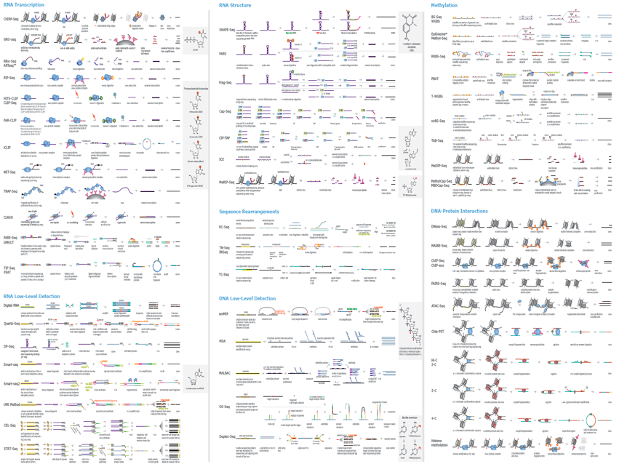
Library prep types

Slide 11
Library prep determines start material
and sequencing method
DNA
RNA
Single cell

Slide 12
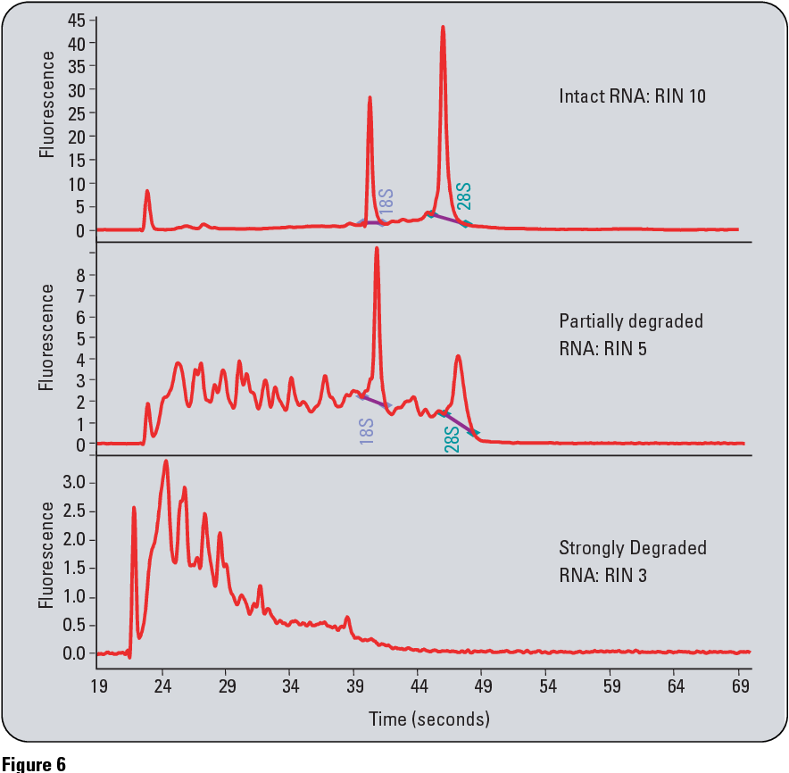
QC
concentration
contamination
degradation
NGS library
Do we have enough to start with
Do we have the correct material to start with
Fragment analyzer
bioanalyzer
Customized methods optional
Nanodrop
Qubit
Customized methods optional

Slide 13
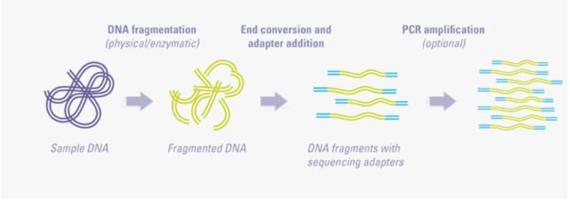
DNA Library prep
DNA
Short read methods (Illumina)

Slide 14
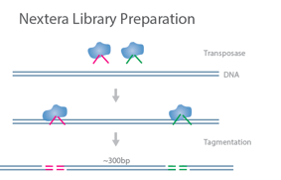
DNA Library prep
DNA
Short read methods (Illumina)
Fragmentation
*enzymatic
*mechanical
*tagmentation

Slide 15
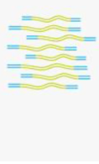
DNA Library prep
enrichment
DNA
Short read methods (Illumina)
Subselecting particlar regions of interest
Whole genome sequencing
PCR-free
With PCR (low input)
Targeted sequencing
MIPs
Amplicons
Probe enrichment

Slide 16
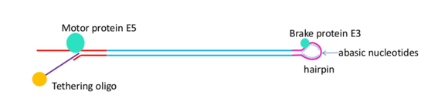
DNA Library prep
DNA
No or very little fragmentation
Input quality is even more important
Long read methods
(ONT/Pacbio)
Notes:
Choice is made based on biological question

Slide 17
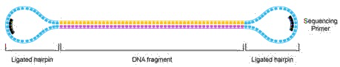
DNA Library prep
DNA
No or very little fragmentation
Input quality is even more important
Various library prep methods
Long read methods
(ONT/Pacbio)
Key Advantages:
Structurally linear
Topologically circular
Provides sequences of both forward and reverse strands in the same trace
Notes:
Choice is made based on biological question

Slide 18

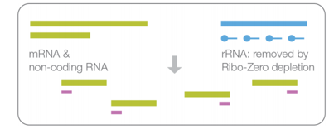
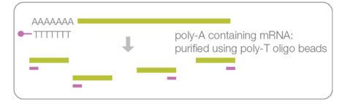
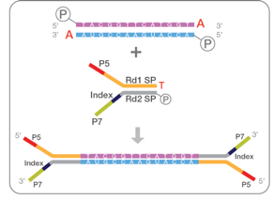
RNA Library prep
RNA
RNA
Short read methods (Illumina)
+

Slide 19
RNA Library prep
 | Differential expression | Whole transcript, fusion, isoforms | Small RNA | Illumina compatible | Sample QC
Lexogen QuantSeq 3’ mRNA | ✔️ |  |  | ✔️ | robust
Lexogen Small RNA seq | ✔️ |  | ✔️ | ✔️ | robust
Illumina TruSeq stranded mRNA | ✔️ | ✔️ |  | ✔️ | sensitive
Illumina TruSeq stranded total RNA | ✔️ | ✔️ | ✔️ | ✔️ | sensitive
Bioke mRNA or total RNA seq | ✔️ | ✔️ | ✔️ | ✔️ | robust
RNA
Short read methods (Illumina)

Slide 20
RNA Library prep
 | Differential expression | Whole transcript, fusion, isoforms
IsoSeq Pacbio | (✔️) | ✔️
Direct RNA (ONT) | (✔️) | ✔️
cDNA based RNA (ONT) | (✔️) | ✔️
RNA
Long read methods
(ONT/Pacbio)

Slide 21
Single cell Library prep
Key to label single cell input material with specific tag
Single cell

Slide 22
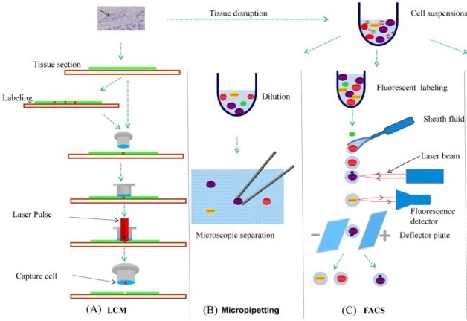
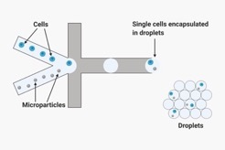
Single cell Library prep
Key to label single cell input material with specific tag
Isolating your cells
Single cell genomics
Laser microdissection
micropipetting
FACS
Microfluidics systems

Slide 23
Single cell Library prep
 | RNA type | Transcript targeted | sensitivity | throughput | sequencing | Specific property
SMART SEQ2 | mRNA | full transcript | sensitive | low | deep | FACS sorting specific populations
10x 3’ RNA seq | mRNA | 3’ end | medium | High (> 10000) | shallow | Can be combined with surface markers
10x 5’ GEX | mRNA | 5’ end + T or B cell receptor | medium | High (> 10000) | shallow | Can be combined with surface markers
10x Multiome | mRNA + DNA | 3’ end + ATAC based info | medium | High (> 10000) | shallow | Requires nuclei
Single cell genomics
Notes:
Currently short read only, no routine offering for long read. We have tested a number of alternative protocols but currently none stand out. Open to collaborations.

Slide 24
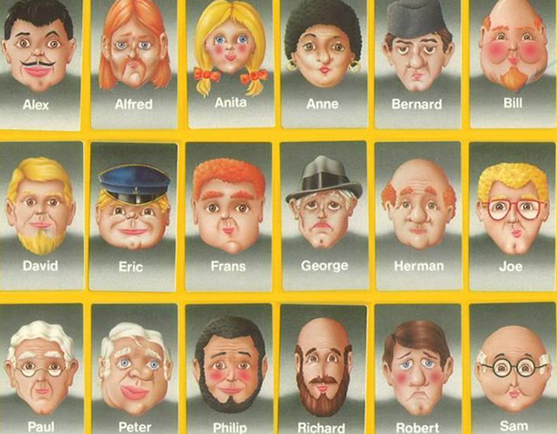
Case example
Request for RNA seq
Material from human samples
Several patients
3 controls, 3x treatment 1, 3x treatment 2
Lexo-gen small RNA
Lexo-gen mRNA
Pac-bio
isoSeq
ONT
Tru-Seq mRNA
Tru-Seq total
Bioke mRNA
Bioke total
Notes:
Currently short read only, no routine offering for long read. We have tested a number of alternative protocols but currently none stand out. Open to collaborations.

Slide 25
Case example
Request for RNA seq
Material from human samples
Several patients
3 controls, 3x treatment 1, 3x treatment 2
Lexo-gen small RNA
Lexo-gen mRNA
Pac-bio
isoSeq
Comparison of the conditions, no interest in splicing, transcriptome build, native RNA
ONT
Tru-Seq mRNA
Tru-Seq total
Bioke mRNA
Bioke total
Notes:
Currently short read only, no routine offering for long read. We have tested a number of alternative protocols but currently none stand out. Open to collaborations.

Slide 26
Case example
Request for RNA seq
Material from human samples
Several patients
3 controls, 3x treatment 1, 3x treatment 2
Lexo-gen small RNA
Lexo-gen mRNA
Pac-bio
isoSeq
Comparison of the conditions no interest in splicing, transcriptome build, native RNA
ONT
Tru-Seq mRNA
Tru-Seq total
Focus on transcriptome
Bioke mRNA
Bioke total
Notes:
Currently short read only, no routine offering for long read. We have tested a number of alternative protocols but currently none stand out. Open to collaborations.

Slide 27
Case example
Request for RNA seq
Material from human samples
Several patients
3 controls, 3x treatment 1, 3x treatment 2
Lexo-gen small RNA
Lexo-gen mRNA
Pac-bio
isoSeq
Comparison of the conditions no interest in splicing, transcriptome build, native RNA
ONT
Tru-Seq mRNA
Tru-Seq total
Focus on transcriptome
Some samples might be bad quality
Bioke mRNA
Bioke total
Notes:
Currently short read only, no routine offering for long read. We have tested a number of alternative protocols but currently none stand out. Open to collaborations.

Slide 28
Case example
Request for RNA seq
Material from human samples
Several patients
3 controls, 3x treatment 1, 3x treatment 2
Lexo-gen small RNA
Lexo-gen mRNA
Pac-bio
isoSeq
Comparison of the conditions no interest in splicing, transcriptome build, native RNA
ONT
Tru-Seq mRNA
Tru-Seq total
Focus on transcriptome
Some samples might be bad quality
Bioke mRNA
Bioke total
Want to match it to other RNA data for which they have full length transcript info
Notes:
Currently short read only, no routine offering for long read. We have tested a number of alternative protocols but currently none stand out. Open to collaborations.

Slide 29
General workflow
material of interest
Input prep and QC
Library
Data analysis

Slide 30
You are all set to start your first NGS experiment!
Still not sure on how to proceed?
Contact the Genomics Core for more info
info@genomicscore.be

